Slide 1
NLP MODEL
Classifying toxic comments
Presented by Divya Sundar, Tracy Wei, and Selena Gabrielle
MENTORED BY: Prithvi Shetty, a data scientist at SAP Concur
Notes:
TRACY

Slide 2


PROBLEM
1 in 10 young people have been exposed to online bullying- there are clear connections between cyber hate and mental health problems.
Critical exchange or differing opinions, shown through toxic comments often, can easily achieve their desired effect towards others.
Notes:
TRACY

Slide 3
SOLUTION
Step 1
Step 2
Step 3
Get data and
cleaning it
Tokenization & Preprocessing
Vectorization
Step 4
Step 5
Train with an
ML model
Tuning for accuracy & implementation with Flask
Notes:
TRACY

Slide 4

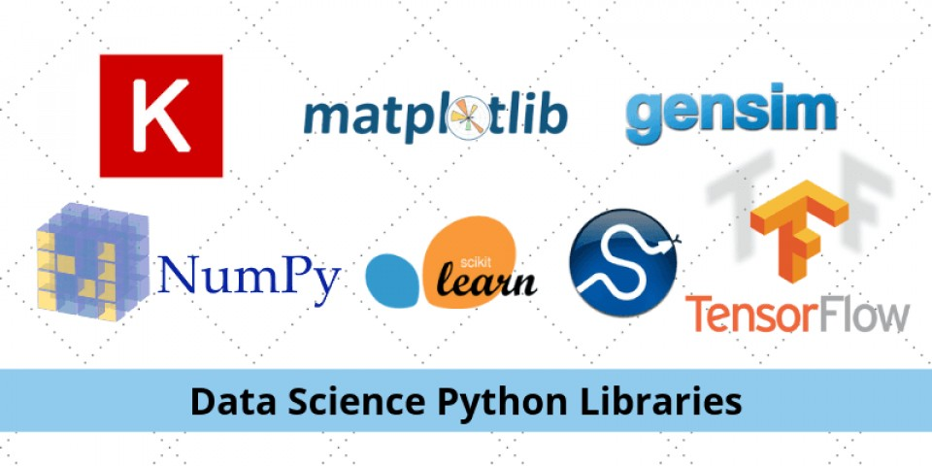

TECHNOLOGIES & ARCHITECTURES USED
Jupyter Notebook
Python Libraries (ntlk, pandas, numpy, sklearn)
Web Application Flask
Notes:
TRACY

Slide 5
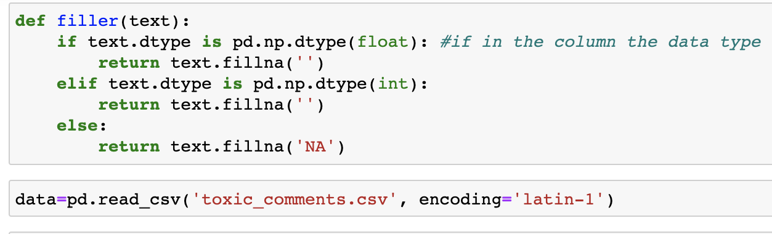
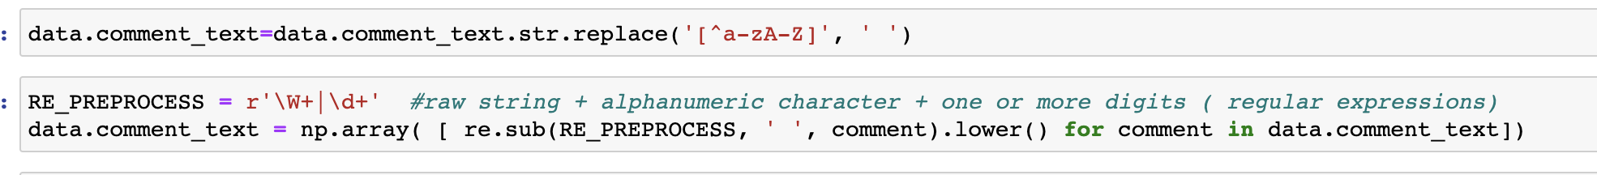
STEP 1: Getting the Data & Cleaning It
Remove white space
Lowercase text
Remove non-alphanumeric characters
Notes:
SELENA

Slide 6
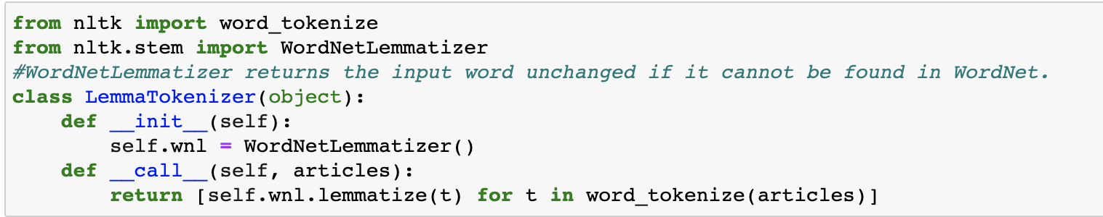
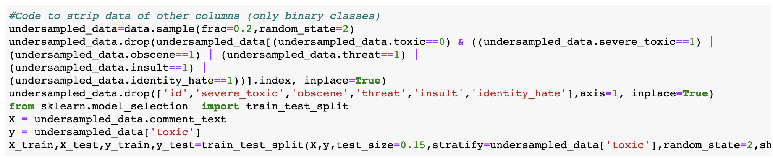
STEP 2: Tokenization & Stripping the Columns
Stemming
Lemmatization
Remove stop words
Tokenization
Stripping the data of other columns
Notes:
SELENA

Slide 7
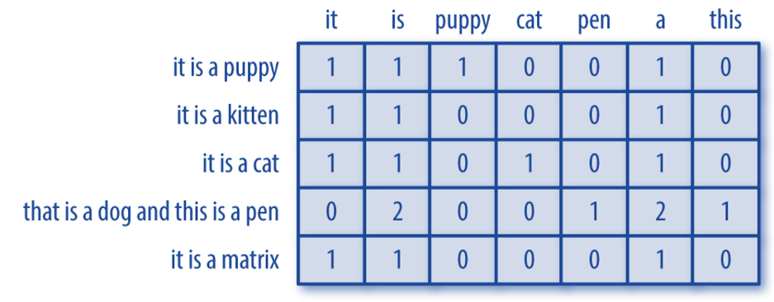
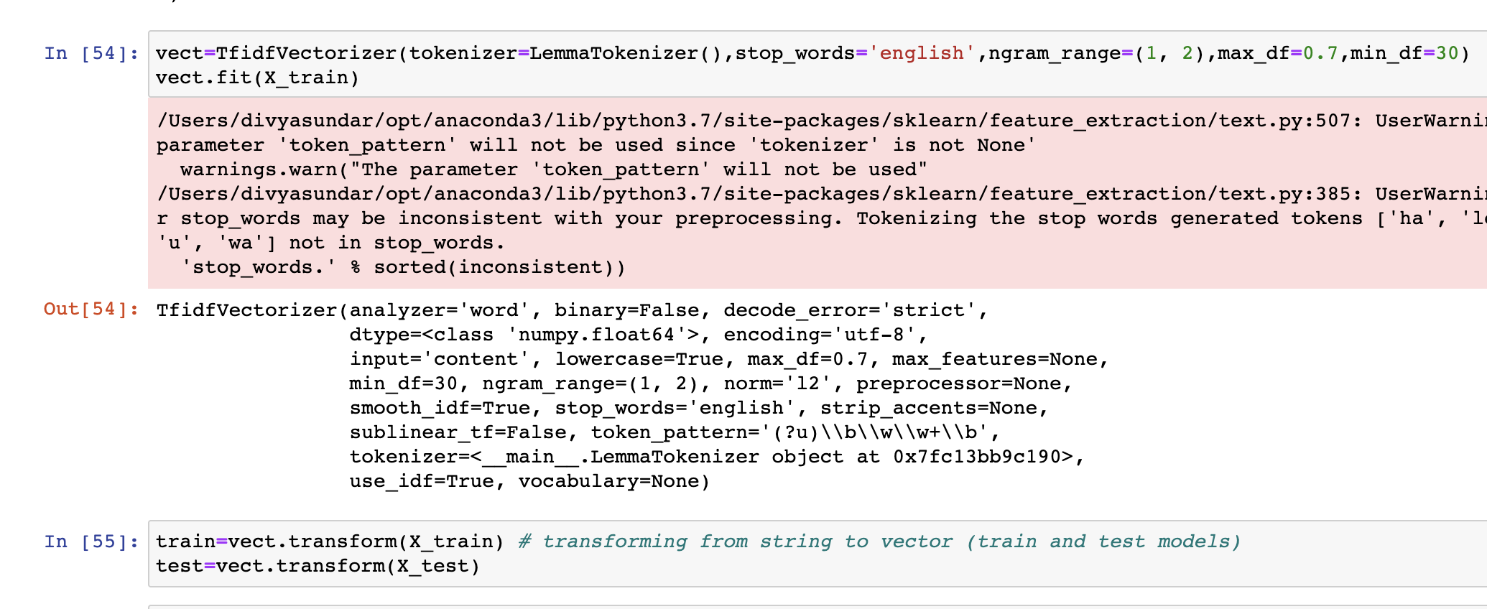
STEP 3: Vectorization
Vectorization
CountVectorizer
Term Frequency - Inverse Document Frequency
Notes:
SELENA

Slide 8
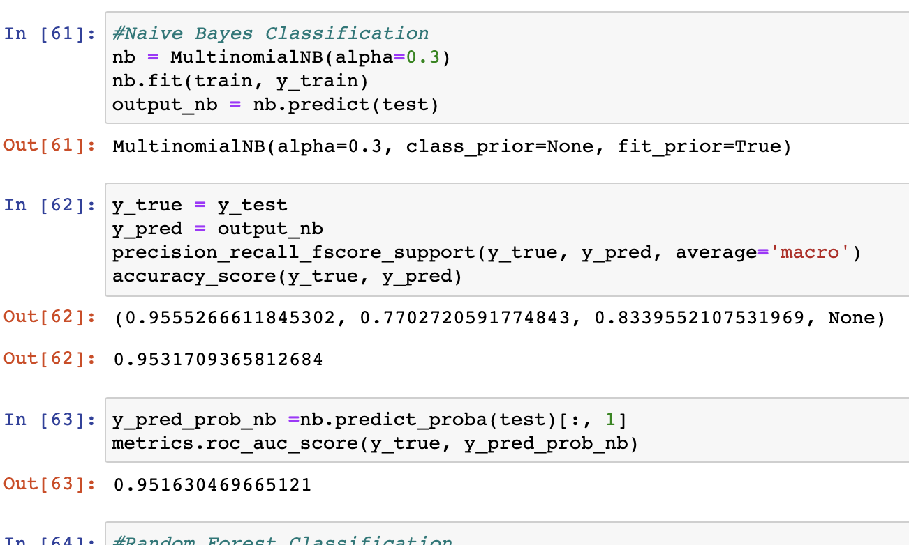
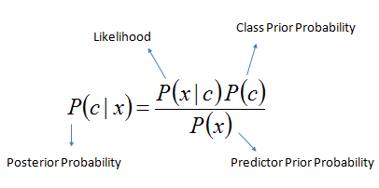
Naive Bayes
STEP 4: Machine Learning Model
concept
code snippet
Notes:
DIVYA

Slide 9
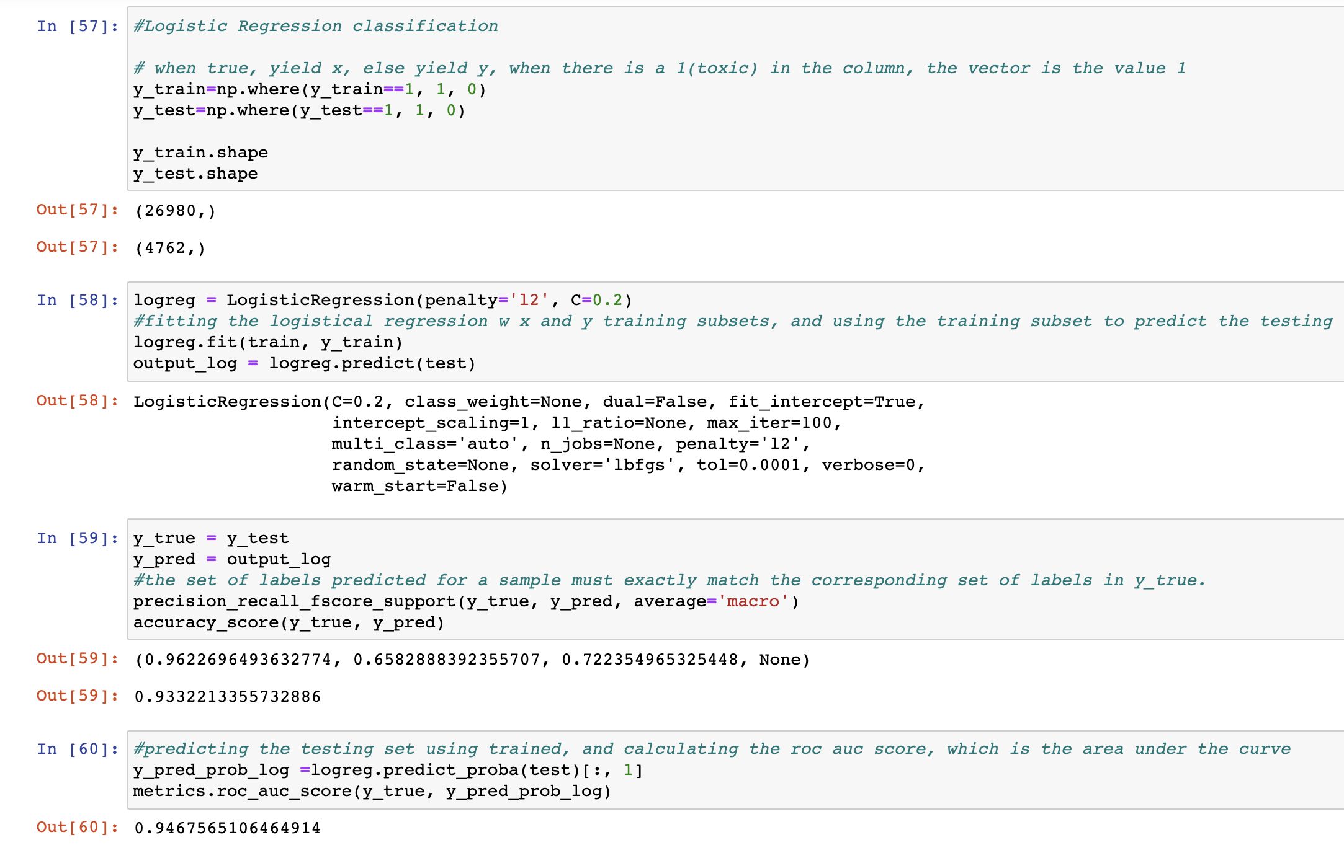
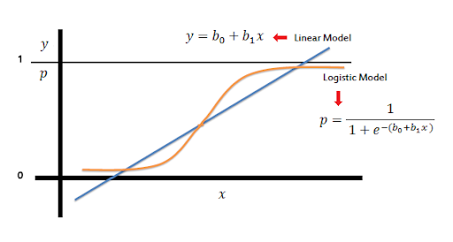
Logistic Regression
STEP 4: Machine Learning Model
concept
code snippet
Notes:
TRACY

Slide 10
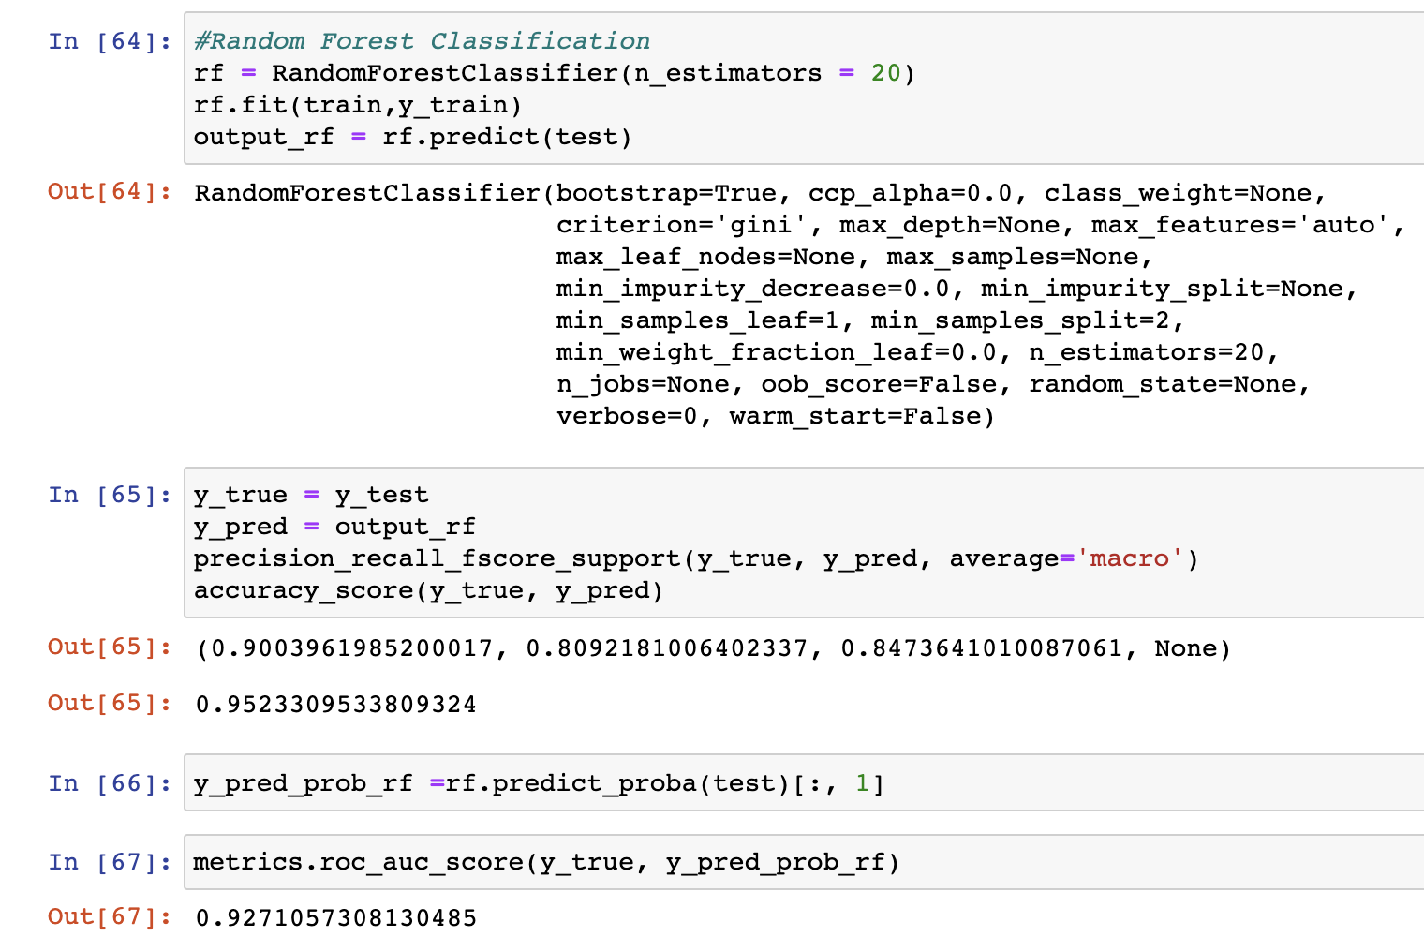

Random Forest Classification
STEP 4: Machine Learning Model
concept
code snippet
Notes:
SELENA

Slide 11
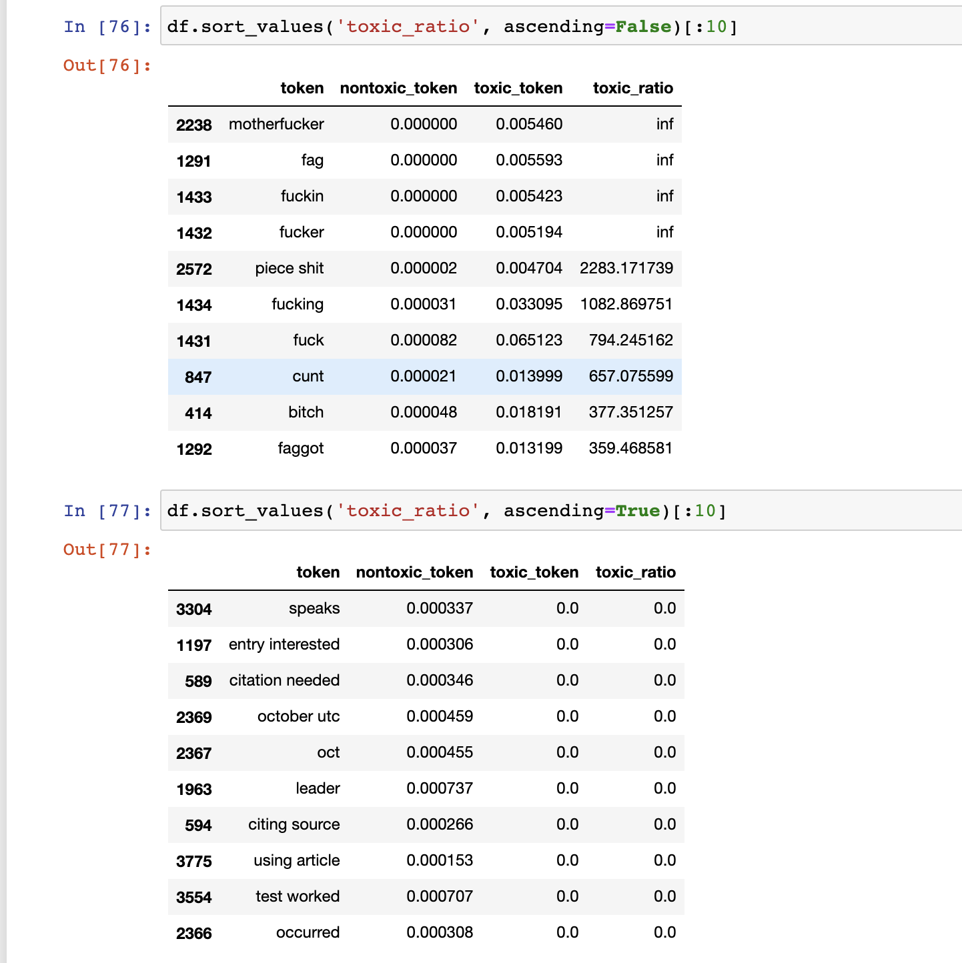
STEP 5: Tuning for Accuracy & Implementation with Flask
Tuning Hyperparameters
Training the Best ML Model
Deploying the Model to Flask
(censored swear words)
Notes:
DIVYA

Slide 12
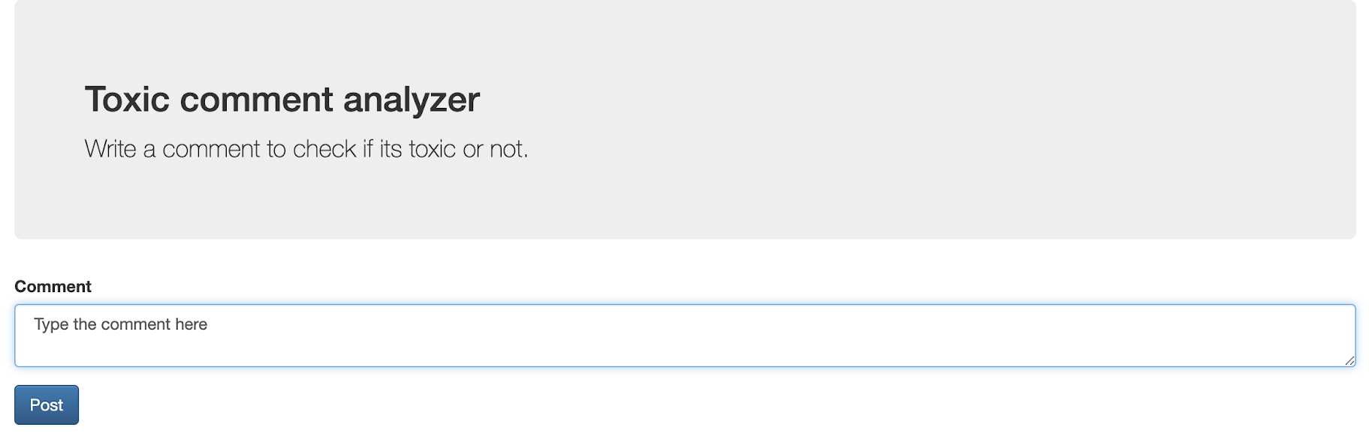
Flask Application
STEP 5: Tuning for Accuracy & Implementation with Flask
Notes:
DIVYA

Slide 13
LESSONS LEARNED
This was the first time that all of us worked with machine learning and natural language processing, so we all learned so much about these topics, specifically with...
Different types of ML algorithms for NLP: naive bayes, random tree classification, logistic regression
NLP concepts: tokenization (lemmatization, stemming, stop words), vectorization (bag-of-words approach), cleaning data
Notes:
DIVYA

Slide 14
FURTHER WORK
We aim to make our web application with Flask more user-friendly by redesigning the UI using HTML and CSS
Additionally, we are interested in integrating our NLP model into websites and applications that contain commentary features, such as social media
We are also interested in refining our NLP model and its purpose to detect more specific problems, like racial slurs or biases within language
Notes:
TRACY

Slide 15
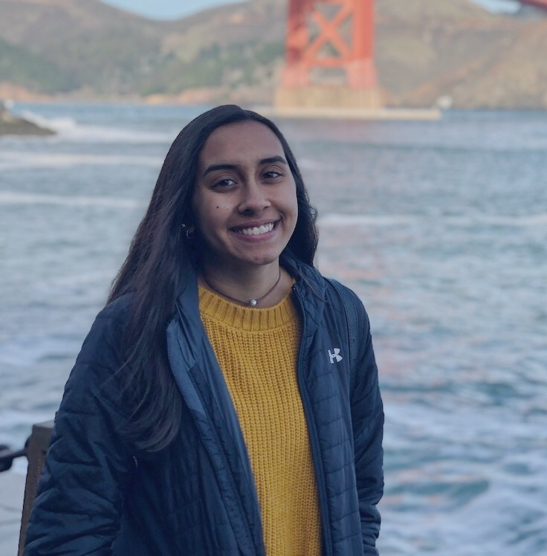
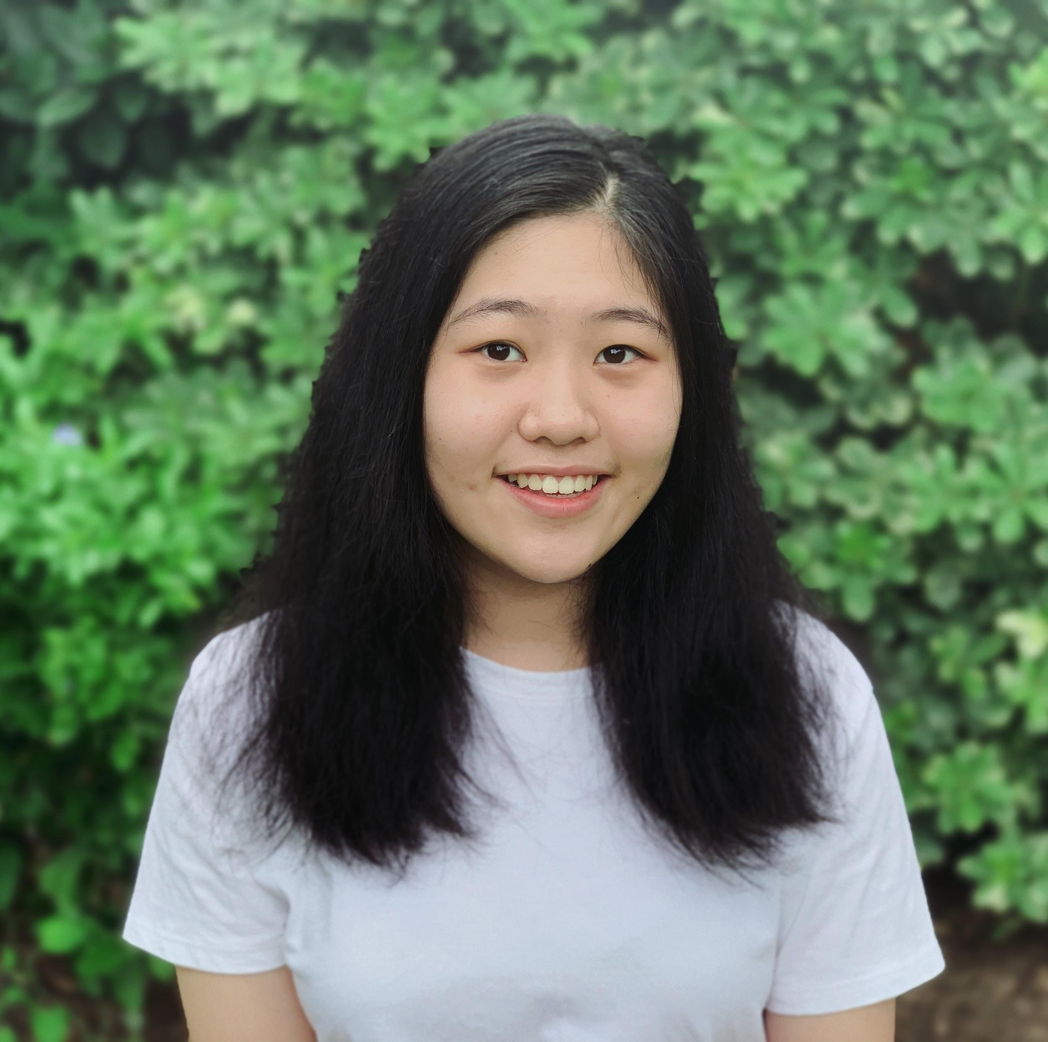

CONTACT INFO
DIVYA SUNDAR
TRACY WEI
SELENA GABRIELLE
divsundar9@gmail.com
www.linkedin.com/in/divyasundar16
tracywei27@gmail.com
skgabrielle@gmail.com
www.linkedin.com/in/tracy-wei
www.linkedin.com/in/selena-gabrielle
Notes:
EACH SAY OUR OWN

